Slide 1
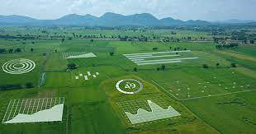
SMART AGRICULTURE (USING IOT)
BY:
LAVANYA SREE S
INFORMATION TECHNOLOGY
VELAMMAL ENGINEERING COLLEGE

Slide 2
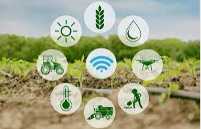
300 SECOND CONTENTS:
ABSTRACT
OUR IDEAS
PROPOSED SOLUTION
BLOCK DIAGRAM
ADVANTAGES OF THIS METHOD
DESIGN
FUTURE IMPLEMENTATION
CONCLUSION

Slide 3
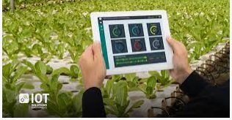
ABSTRACT
Smart farming is an emerging concept , because IOT sensors capable of providing information about their fields .
IOT in agriculture uses robots, drones, remote sensors, and computer imaging combined with continuously progressing machine learning
The purpose of SMART AGRICULTURE is to detect various problems of farmers and provide a solution by using 3 Ways Soil Meter sensor, soil moisture sensor and passive infrared sensor.

Slide 4
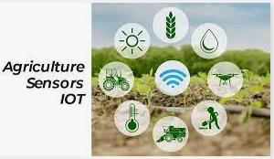
OUR IDEA
Three different soil test meters in one device: It measures moisture content in soil, pH/Acidity/Alkalinity, and light intensity(sun rays)
Water wasted through irrigation can be conserved by soil moisture sensor
PIR (Passive Infrared) Sensors can be used to prevent harm caused by predators by detecting the motion of animals and scars the animal away from the field by using buzzers and creating alarm.
GSM : Keeps the farmer updated frequently about their field status, especially when an inconvenience occurs.

Slide 5
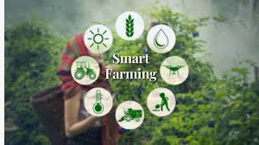
OBJECTIVE
It control pH level in soil, acidic or alkaline is suitable for your plants, tests whether plants are getting adequate sunlight or not.
The moisture in the soil is measured by using soil moisture sensor, the sensor measures the moisture content and based on the moisture content , it turns on or off the motor.
Passive Infrared(PIR)sensor detects infrared light radiated by a warm object.
IOT connects all the sensors and sends their values and messages to the system for display .

Slide 6
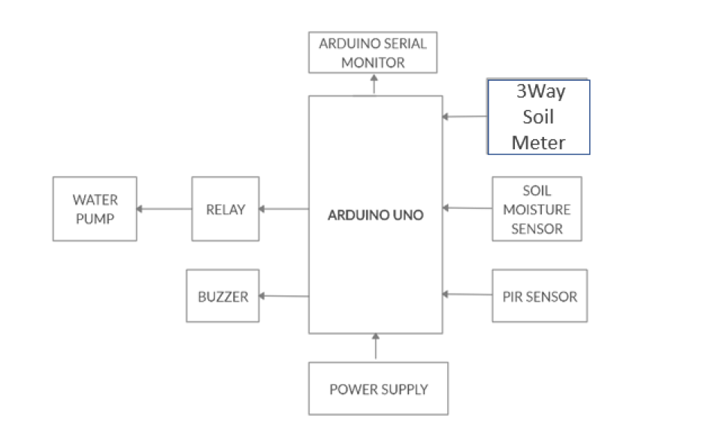
BLOCK DIAGRAM

Slide 7
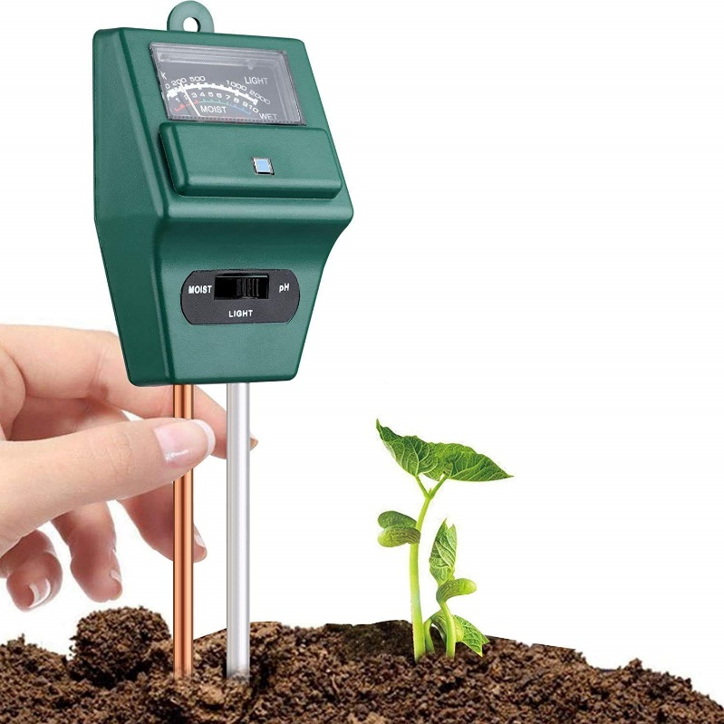
3- way SOIL METER
Let’s you know that soil is dry or not.
It control pH level in soil, acidic or alkaline is suitable for your plants.
Tests whether plants are getting adequate sunlight or not.

Slide 8
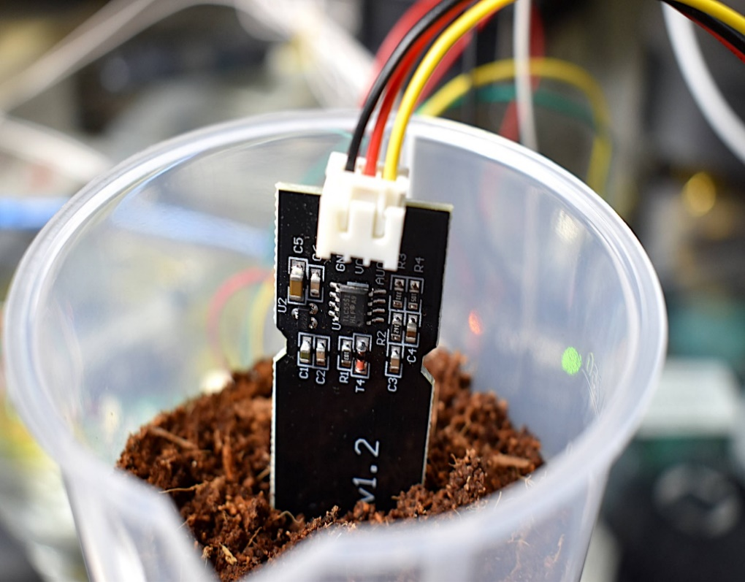
SOIL MOISTURE SENSOR
The moisture in the soil is measured by using soil moisture sensor .
The sensor measures the moisture content and based on the moisture content , it turns on or off the motor.

Slide 9
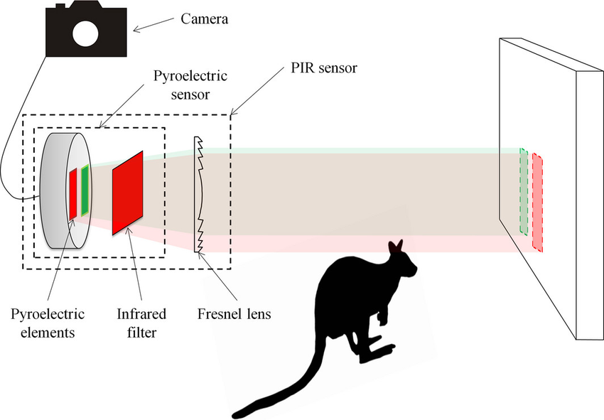
PASSIVE INFRARED SENSOR
PIR sensor detects infrared light radiated by a warm object.

Slide 10
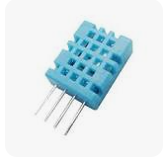
TEMPERATURE AND HUMIDITY SENSOR
The DHT-11 Digital Temperature And Humidity Sensor is a basic, ultra low-cost digital temperature and humidity sensor.
It uses a capacitive humidity sensor and a thermistor to measure the surrounding air and spits out a digital signal on the data pin (no analog input pins needed).

Slide 11
DESIGN OF OUR PROJECT

Slide 12
Future implementation
For future developments it can be enhanced by developing this system for large acres of land.
The sensors and microcontroller are successfully interfaced and wireless communication is achieved between various nodes.
Instead of using GSM making use of GPRS and controlling those applications through the internet.
Instead of switching of the water pump when single phase is present, convert the single phase power supply to three phase power supply.

Slide 13
CONCLUSION
The goal of smart agriculture research is to ground a decision making support system for farm management.
A system that optimize and examines how high-tech farming can aid the production output as well as focuses on the preservation of resources.
Smart farming can make agriculture more profitable for the farmer.
Decreasing resource inputs will save the farmer money and labor, and increased reliability of spatially explicit data will reduce risks.

Slide 14


